Slide 1
HealthCo (@Risk & FAIR-U) Valuation
Fayza Dholasania, Jack Hu, Shan Maknojia
MIS 373: IT Audit & Security, The University of Texas at Austin
Notes:
Fayza

Slide 2
BACKGROUND
Surgeon distressed due to IAM problems
Numerous M&As with no integrated IT systems
IT silos (lowest-level of maturity) causing cybersecurity issues
One data breach per year over past 10 years
Privacy issues
MRI option of $25.68 Million and a ROI of 100%
IT Budget | $1,500,000,000.00
IT OpEx | $1,200,000,000.00
IT security OpEx | $60,000,000.00
IT CapEx | $300,000,000.00
IT security CapEx | $6,000,000.00
Implement new solution or not?
Notes:
Fayza

Slide 3
RECAP (TCO, NPV, ROI, CLE)
Notes:
Fayza

Slide 4
TCO Using Different Solutions
We didn’t include our insurance savings in our TCO calculations since it is not an operational
We can see the TCO for legacy solution is the lowest.
Therefore, if we are to pick on TCO alone, legacy is the best choice.
 | Year 1 | Year 2 | Year 3 | Year 4 | Year 5 | Total Cost of Ownership
Legacy IAM - Cost of ownership
 | $ 2,880,000.00 | $ 3,048,800.00 | $ 3,228,132.00 | $ 3,418,725.02 | $ 3,621,366.15 | $ 16,197,023.17
SailPoint On-prem IAM - Cost of ownership
 | $ 6,930,008.00 | $ 2,621,558.40 | $ 2,830,194.65 | $ 3,057,577.87 | $ 3,305,539.10 | $ 18,744,878.02
SailPoint SaaS-IAM - Cost of ownership
 | $ 6,170,250.00 | $ 3,273,388.13 | $ 3,607,532.28 | $ 3,975,857.31 | $ 4,381,863.30 | $ 21,408,891.02
Notes:
Shan

Slide 5
Savings on Modules
Single Sign On (SSO) - $231,762.81
Access Requests - $519,252.51
Provisioning - $333,068.92
Password Management - $934,673.19
Certification Campaigns - $1,134,714.58
Audit-Finding Remediations - $1,279,434.68
Notes:
Fayza

Slide 6
On Prem
Total cost of ownership (TCO) for SailPoint's On-Prem-IAM (5 year) |  | $ 18,744,834
Return on Investment (ROI) for SailPoint's On-Prem-IAM (5 year) |  | 101%
Net Present Value (NPV) of SailPoint's On-Prem-IAM (5 year) |  | $ 12,640,198
 | Year 1 | Year 2 | Year 3 | Year 4 | Year 5 | TOTAL
Total Cash Inflows due to productivity savings from SailPoint's On-Prem-IAM | $551,927.52 | $627,142.77 | $707,442.46 | $797,230.47 | $898,675.56 | $3,582,418.78
Cash Inflows (Savings) due to decommissioning of the legacy IAM system | $2,880,000.00 | $3,048,800.00 | $3,228,132.00 | $3,418,725.02 | $3,621,366.15 | $16,197,023.17
Cash Inflows (Savings) due to cyberinsurance premium discount on On-Prem IAM | $750,000.00 | $2,137,500.00 | $3,541,875.00 | $4,994,343.75 | $6,526,504.69 | $17,950,223.44
Total cash outflows to SailPoint for On-prem IAM solution | -$6,930,000.00 | -$2,621,550.00 | -$2,830,185.83 | -$3,057,568.61 | -$3,305,529.37 | -$18,744,833.81
Net cash flows | -$2,748,072.48 | $3,191,892.77 | $4,647,263.63 | $6,152,730.63 | $7,741,017.02 | $18,984,831.57
For each year, we looked at the inflows from savings we found earlier, the removed TCO from legacy system, and discounted insurance savings
The insurance savings are calculated using 15% discounted rate
NPV is calculated using a 10% discount rate with a result of $12,640,198
ROI is 101%
Notes:
Jack

Slide 7
SaaS
Total cost of ownership (TCO) for SailPoint's SaaS-IAM (5 year) |  | $ 21,408,891
Return on Investment (ROI) for SailPoint's SaaS-IAM (5 year) |  | 87%
Net Present Value (NPV) of SailPoint's SaaS-IAM (5 year) |  | $ 12,608,527
 | Year 1 | Year 2 | Year 3 | Year 4 | Year 5 | TOTAL
Total Cash Inflows due to productivity savings from SailPoint's SaaS-IAM | $551,927.52 | $627,142.77 | $707,442.46 | $797,230.47 | $898,675.56 | $3,582,418.78
Cash Inflows (Savings) due to decomissioning of the legacy IAM | $2,880,000.00 | $3,048,800.00 | $3,228,132.00 | $3,418,725.02 | $3,621,366.15 | $16,197,023.17
Cash Inflows (Savings) due to cyberinsurance premium discount on SaaS-IAM | $1,000,000.00 | $2,550,000.00 | $4,052,500.00 | $5,556,375.00 | $7,106,631.25 | $20,265,506.25
Total cash outflows to SailPoint for SaaS-IAM solution | -$6,170,250.00 | -$3,273,388.13 | -$3,607,532.28 | -$3,975,857.31 | -$4,381,863.30 | -$21,408,891.02
Net cash flows | -$1,738,322.48 | $2,952,554.64 | $4,380,542.17 | $5,796,473.18 | $7,244,809.66 | $18,636,057.17
Using the same logic with On Prem, that’s how we got Years 1-5
As for ROI, we subtracted the total cash inflows by the total cash outflows then divided by the total cash outflows to get 87%
We made a positive ROI since we’re at 85% however if we hold onto the investment longer, we would potentially make more return over time.
For NPV we did a 10% discount rate with the net cash flows from year 1-5 to get $12,608,527.
Notes:
Shan

Slide 8
WHY FACTOR IN CLE?
Factoring Cyber Loss Exposure (CLE) is crucial for businesses and organizations to effectively manage and mitigate cybersecurity risks.
By understanding the potential financial impact of cyberattacks, organizations can make informed decisions about risk mitigation strategies and potential cybersecurity investments.
Factoring these savings or costs from cyber loss exposure into financial metrics provides a more comprehensive view of the overall expenses associated with our investment.
Notes:
Shan

Slide 9
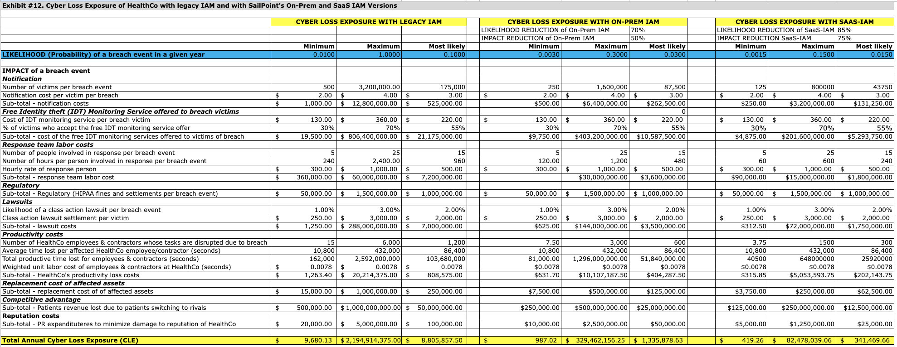
CLE FOR LEGACY, ON PREM, & SAAS
Total
Reduction in Cyber Loss Exposure (CLE) due to investment in SailPoint's SaaS-IAM | $8,464,387.84 | $8,887,607.24 | $9,331,987.60 | $9,798,586.98 | $10,288,516.33 | $46,771,085.98
Total
Reduction in Cyber Loss Exposure (CLE) due to investment in SailPoint's On-Prem-IAM | $7,469,978.88 | $7,843,477.82 | $8,235,651.71 | $8,647,434.30 | $9,079,806.01 | $41,276,348.71
Notes:
Shan

Slide 10
@Risk: Tornado graph and Spider graph
Notes:
Fayza

Slide 11
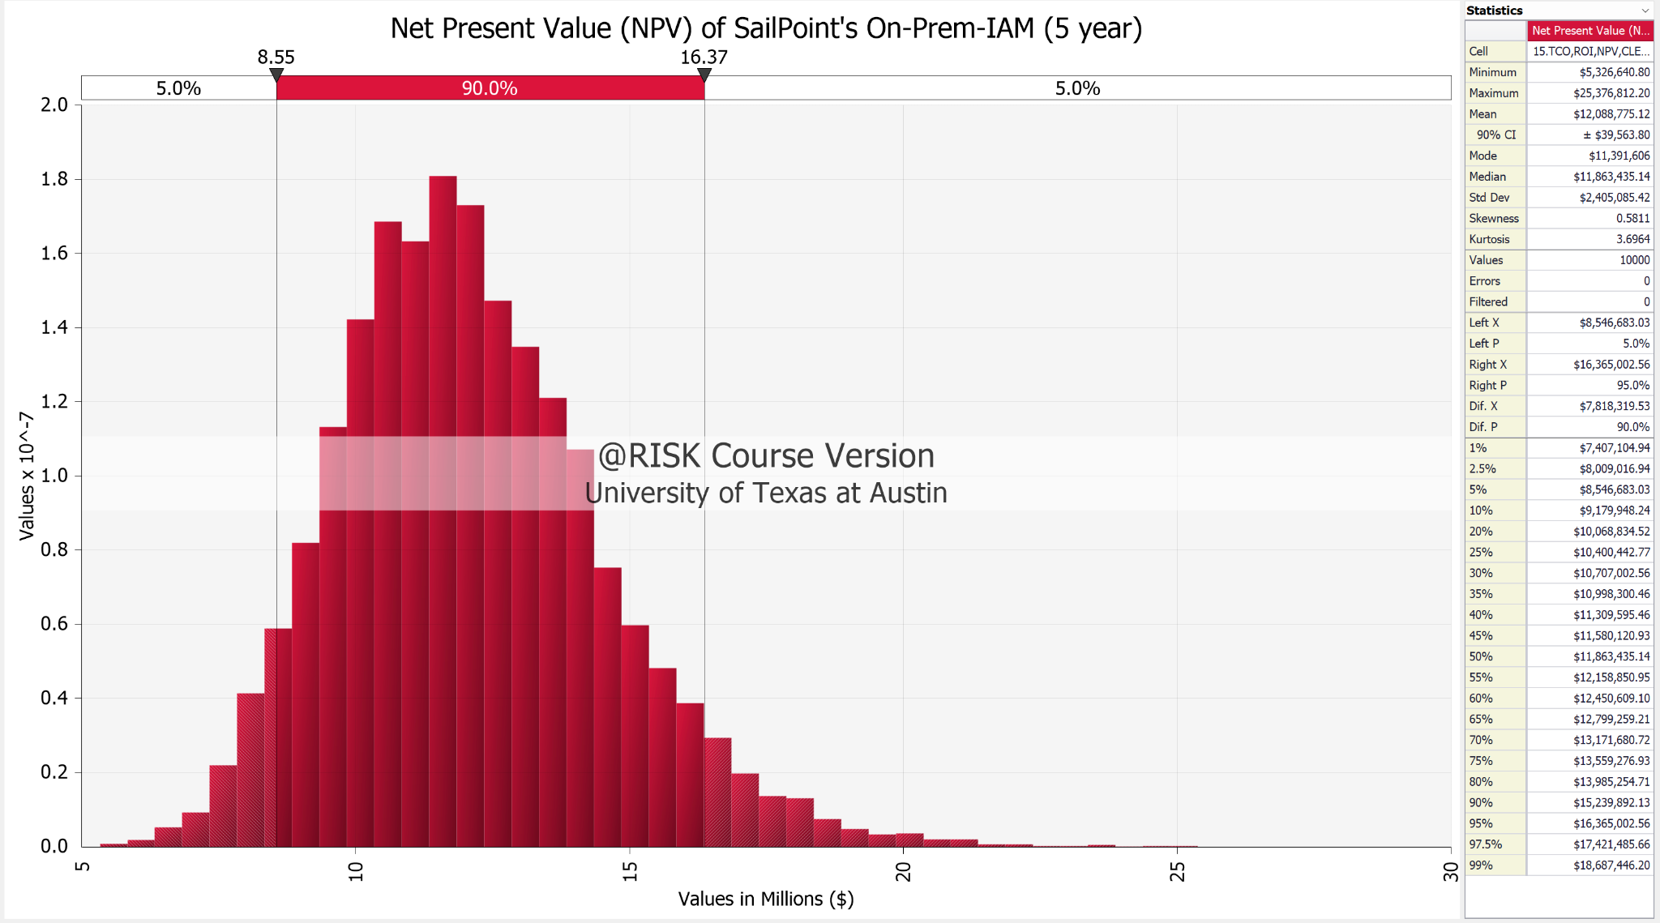
@RISK: OnPrem
The NPV distribution for On-Prem has low variability when compared with SaaS, with a maximum of around 25 million and a minimum of around 5 million dollars.

Slide 12
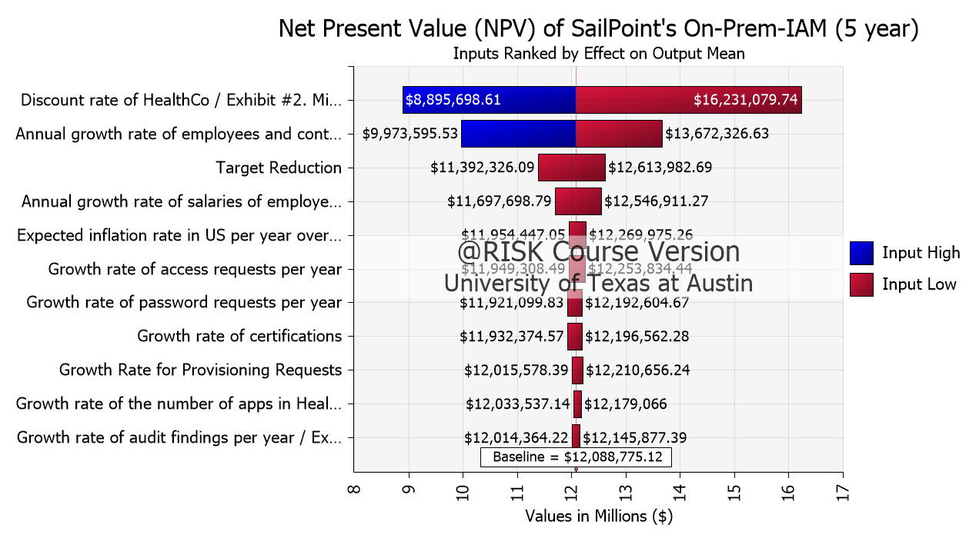
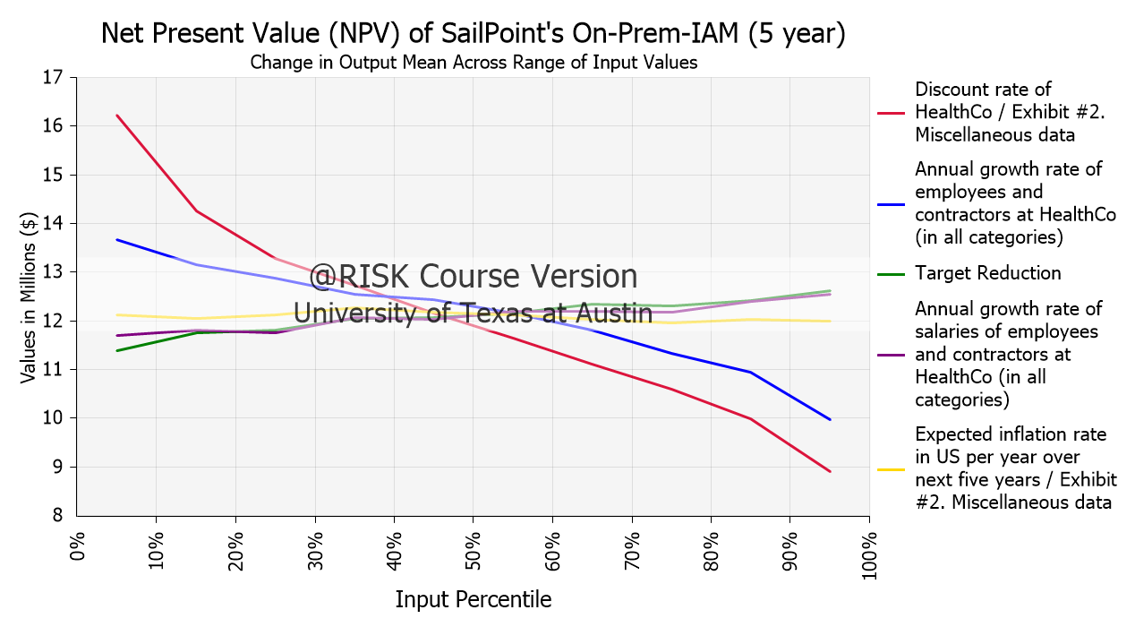
@RISK: OnPrem
Discount rate of HealthCo, the annual growth rate of employees and contractors, the target reduction rate, the growth rate of employee salaries, and the inflation rate are the top 5 factors (Tornado Graph)
The higher the discount rate and the higher the growth rate of employees and contractors, the lower the NPV will be (Spider Graph)

Slide 13
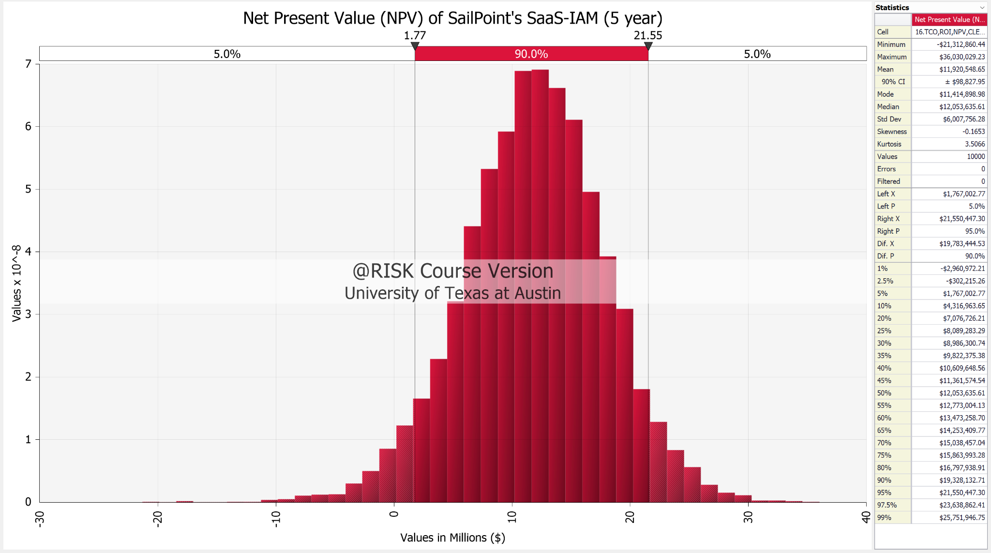
@RISK: SaaS
Although the NPV distribution of SaaS showed a maximum NPV of around 36 million, it also showed a potential minimum NPV of around -21 million.

Slide 14
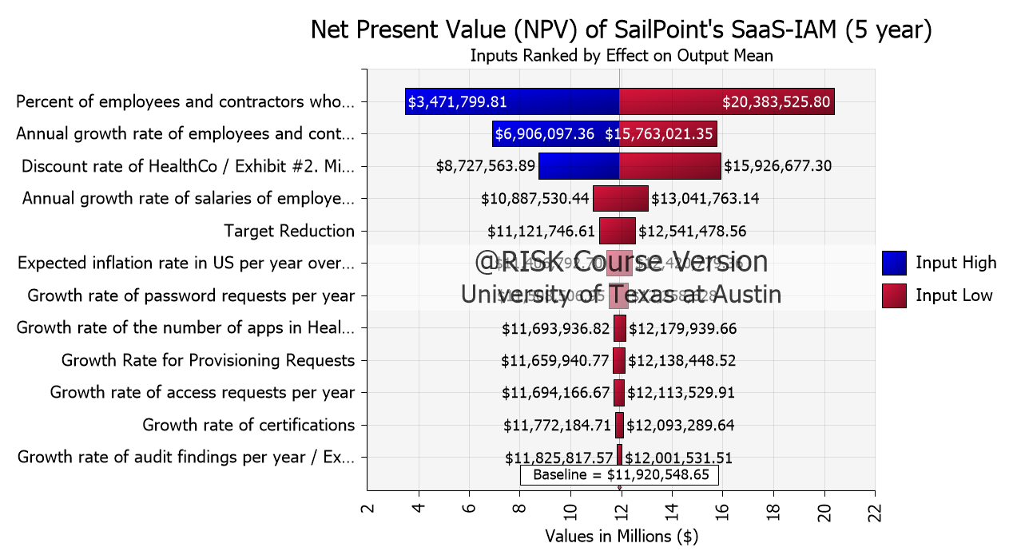
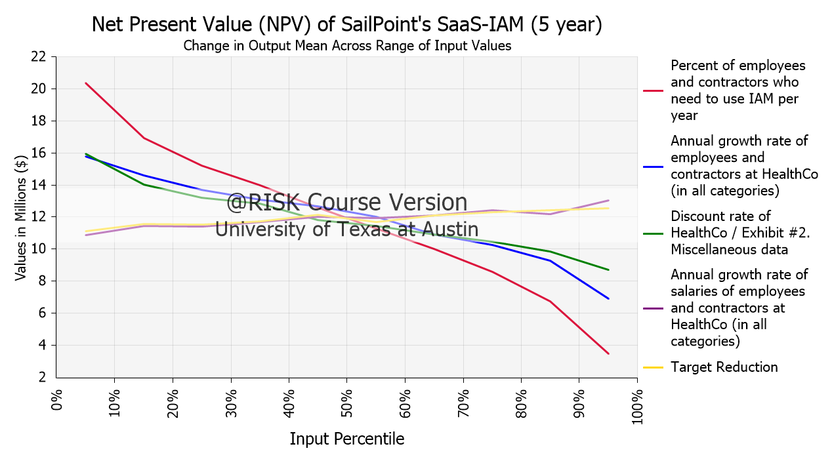
@RISK: SaaS
The percent of employees and contractors who use SaaS, the annual growth rate of employees and contractors, the discount rate of HealthCo, the annual growth rate of employee salaries, and the target reduction rate are the top 5 factors (Tornado Graph)
The higher the percentage of employees and contractors who use IAM, the higher the discount rate, and the higher the growth rate of employees and contractors, the lower the NPV will be (Spider Graph)

Slide 15
FAIR-U: Loss Exceedance Curves
Notes:
Fayza

Slide 16
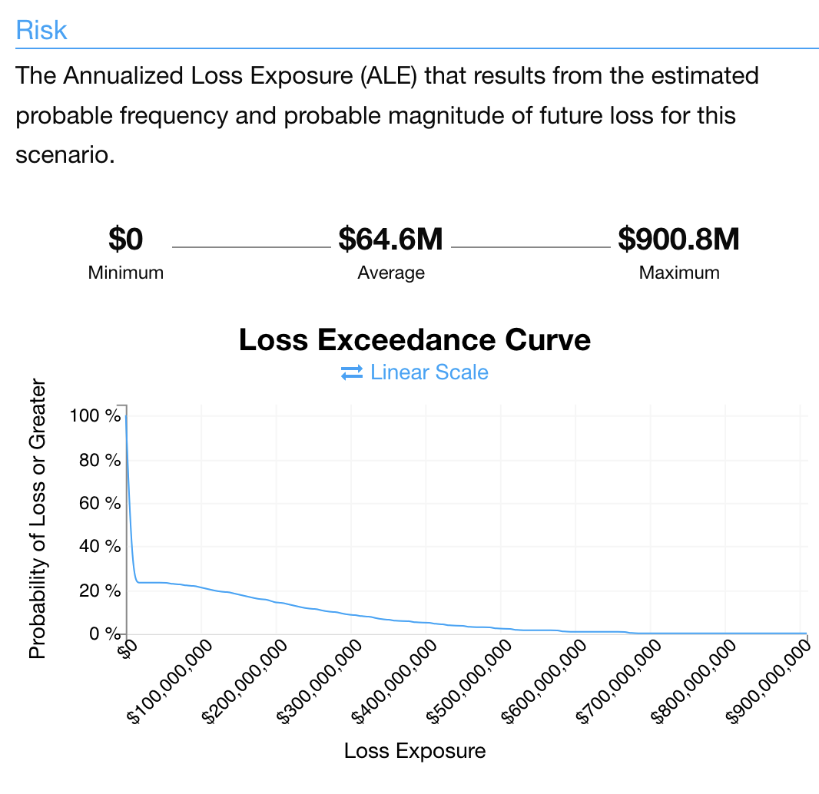
FAIR-U: Legacy
Most loss with a mean loss of around 64.6M
Most area under the loss exceedance curve

Slide 17
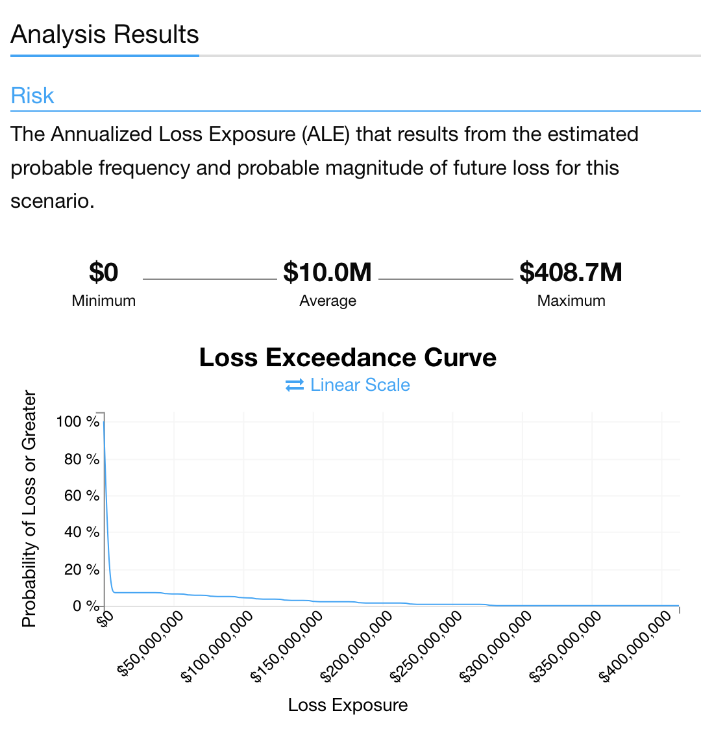
FAIR-U: OnPrem
Greatly reduced the loss from legacy, with a mean loss of around only 10M

Slide 18
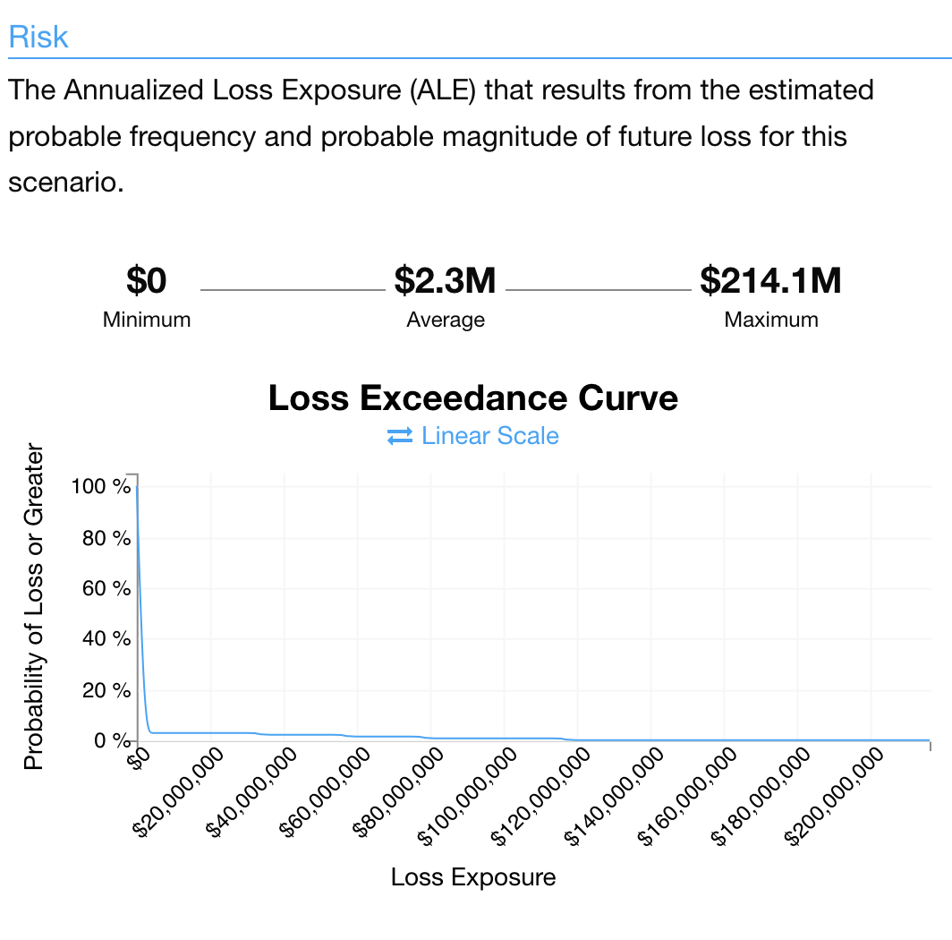
FAIR-U: SaaS
Least loss with only 2.3M
Least area under the loss exceedance curve
Best option if only looking at cyber loss exposure

Slide 19
SUMMARY
Based on NPV (Years 1-5), On Prem is better since it has the highest NPV of about $12,640,198.
Based on ROI (Years 1-5), On Prem is better since it has a 101% ROI.
Based on CLE, the most savings are in SaaS solution.
Based on @Risk, SaaS has the highest maximum reachable NPV of around $36 million. Although SaaS showed a negative minimum value, the NPV is still positive at the 5th percentile. This means there is less than a 5 percent chance that HealthCo will have a negative NPV by adopting the SaaS, making it still a safe option.
Based on FAIR-U, SaaS has the lowest cyber loss exposure as seen on the loss exceedance curves.
In conclusion, based on these two metrics, SaaS is the best option for HealthCo.
Although the SaaS solution does not have a high NPV like the option of the 10 MRI machines, the solution is better since it meets the business’s strategic goal of lowering cyber threats and increasing IAM performance within the organization.
The first year net cash flow for SaaS is -$1,738,322.48 which is also below the budget for both IT security OpEx and CapEx. Therefore, HealthCo. can implement the SaaS and MRI proposals without being over budget.
Compared to On Prem, SaaS has comparable results to NPV of about $12,608,527, which is only $31,671 off from On Prem. It also have a positive ROI of 87%. It is important to note that HealthCo has had multiple M&As, so SaaS offers greater scalability. Additionally, the provider of the SaaS will be responsible for maintenance, security, and support, which will reduce the burden for HealthCo.
Notes:
Fayza

Slide 20
THANK YOU

